Slide 1
FRE mini-talks
My OOD journey so far - 2019/2022
Daniel Sikar
PhD Candidate City University of London
Robust Water Segmentation Researcher - Fujitsu Research of Europe

Slide 2
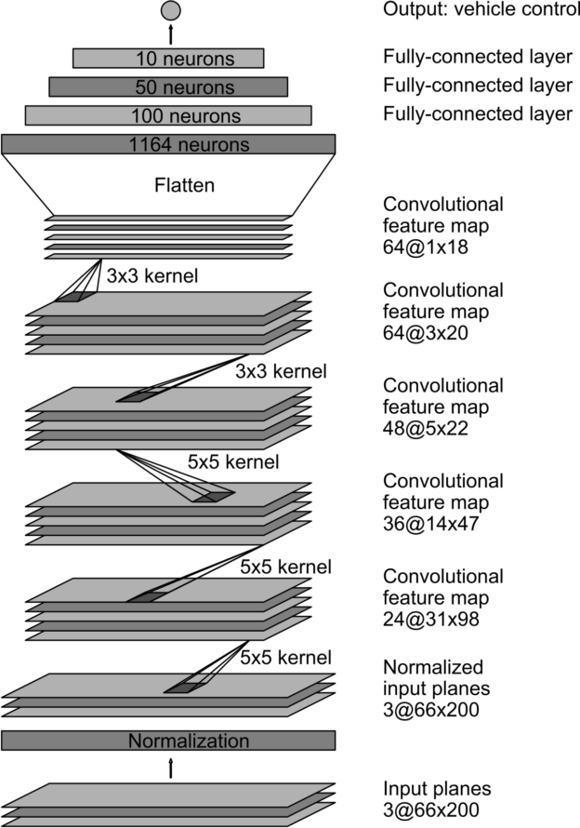
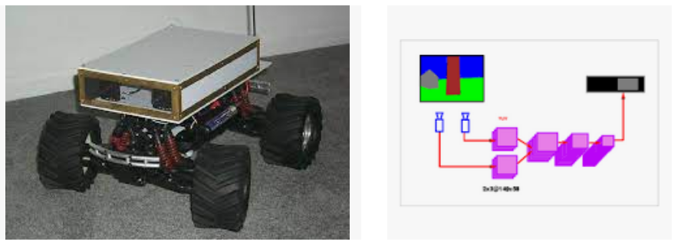
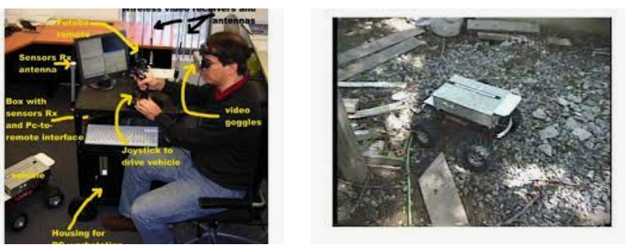
Related Work
Bojarski et al., 2017 - End to End Learning for Self-Driving Cars
LeCun et al., 2004 - Autonomous Off-Road Vehicle Control using End-to-End Learning

Slide 3
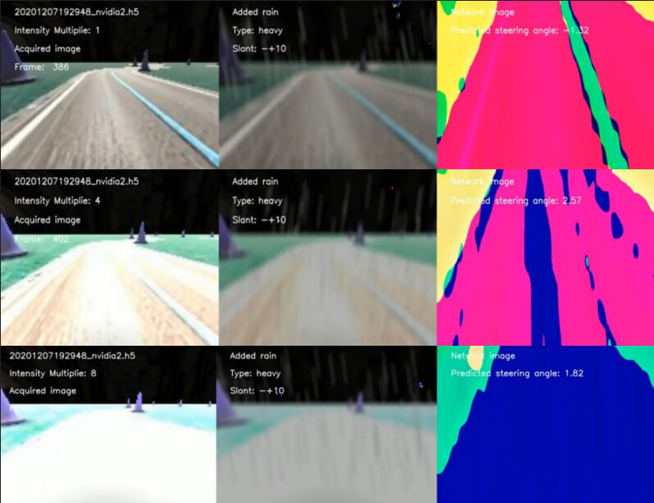
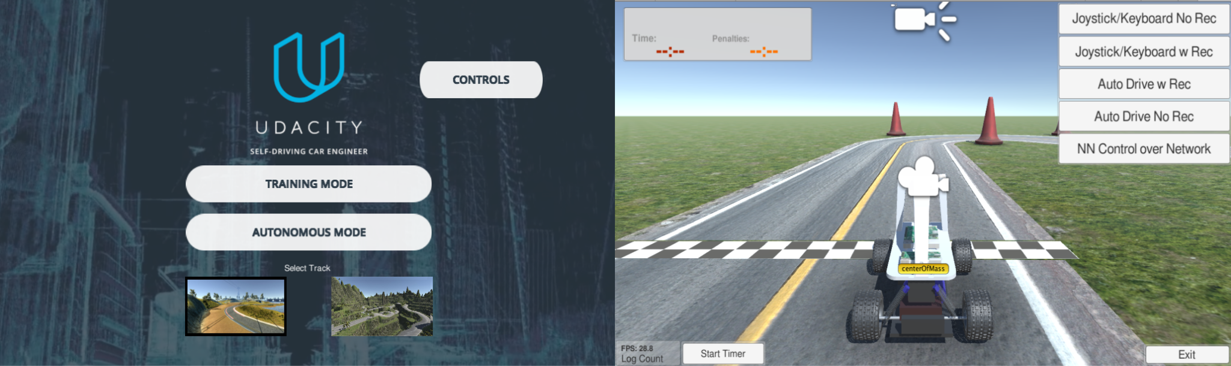
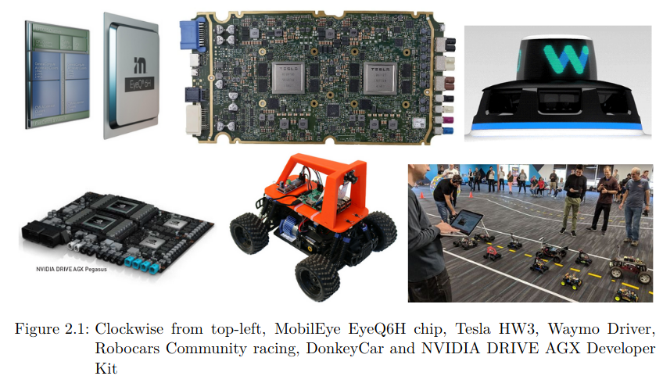
MSc Data Science
Evaluation of self-driving cars using CNNs in the rain

Slide 4
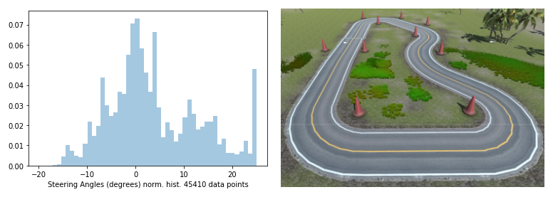
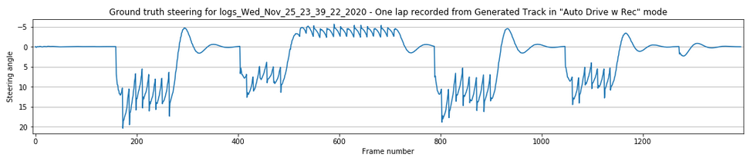
Evaluation of self-driving cars using CNNs in the rain
SD Sandbox PID steering prediction histogram for Generated Track
SD Sandbox PID steering prediction

Slide 5
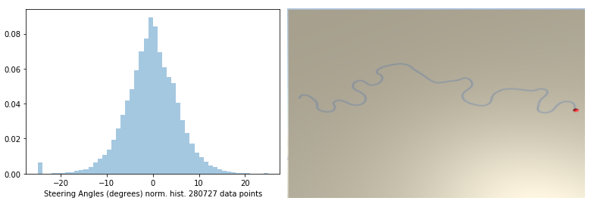
Training dataset - Evaluation of self-driving cars using CNNs in the rain
871403 files in directory .
25562 files in directory ./roboRacingLeague
25795 files in directory ./log_sample
82245 files in directory ./warehouse
44496 files in directory ./quarantine
90842 files in directory ./smallLoop
516997 files in directory ./genRoad
16570 files in directory ./genTrack
68886 files in directory ./smallLoopingCourse
Generated Road PID steering angles histogram

Slide 6
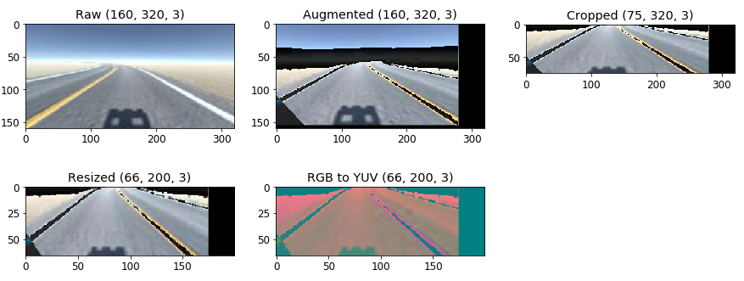
Pre-processing and augmentation at training time

Slide 7
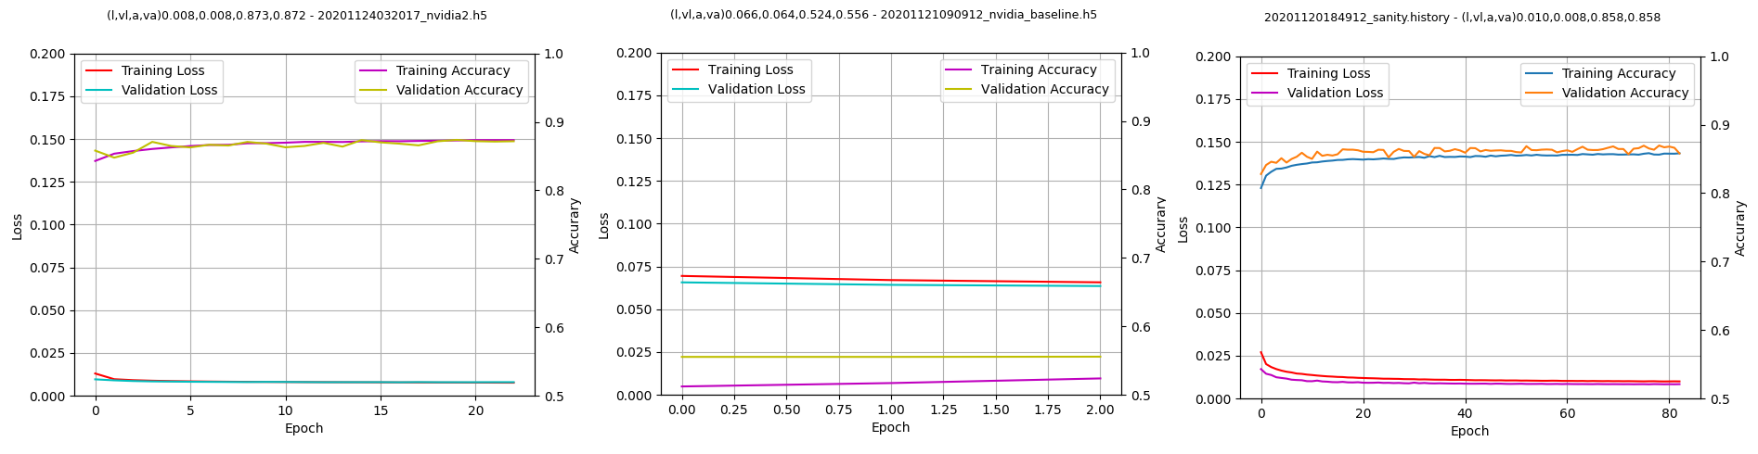
Training
Training time: 4:06:55
Training time: 0:05:25
Training time: 16:08:01

Slide 8
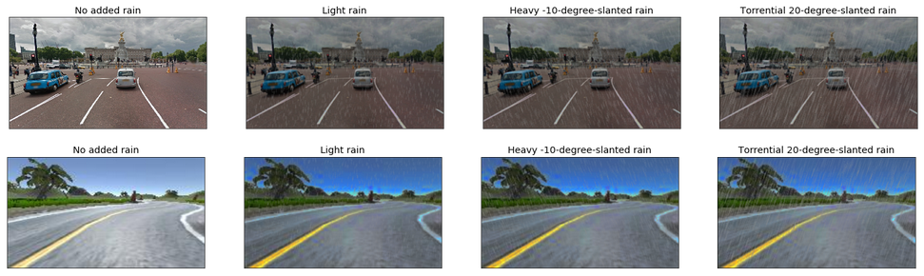
Added rain at evaluation time
Add pre-processing minus augmentation (i.e. keep crop, resize, RGB to YUV) plus rain-like noise

Slide 9
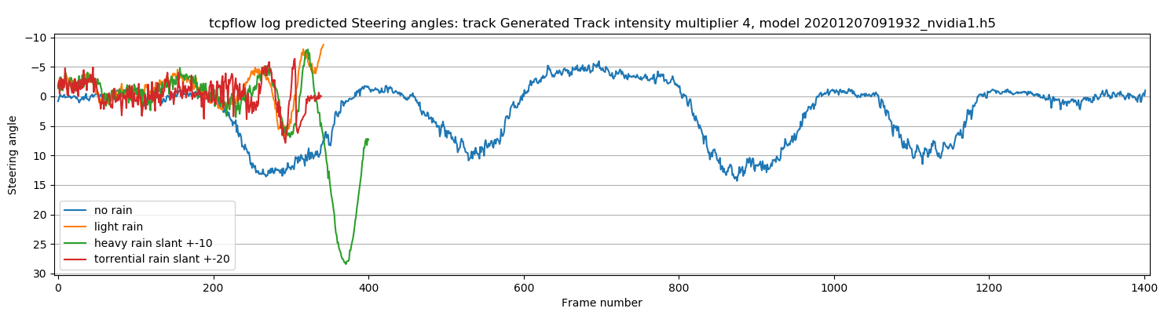
At evaluation time
Ground truth
Added rain at evaluation time - https://youtu.be/sKyoke3IO84

Slide 10
Evaluation of self-driving cars using CNNs in the rain
Conclusions
Small is better
Models are quick to train
CNN geometry matters
https://github.com/dsikar/sdsandbox

Slide 11
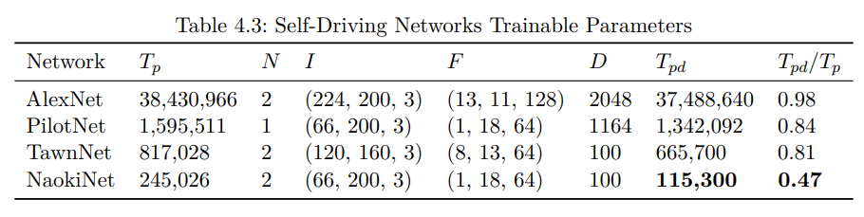
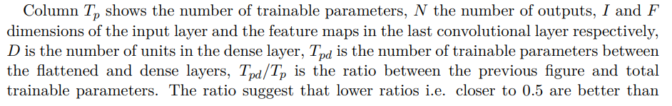
Evaluation of self-driving cars using CNNs in the rain
Conclusions - Small is better

Slide 12
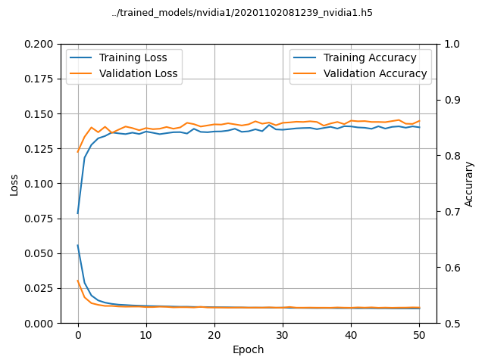
Evaluation of self-driving cars using CNNs in the rain
Conclusions - Models are quick to train

Slide 13
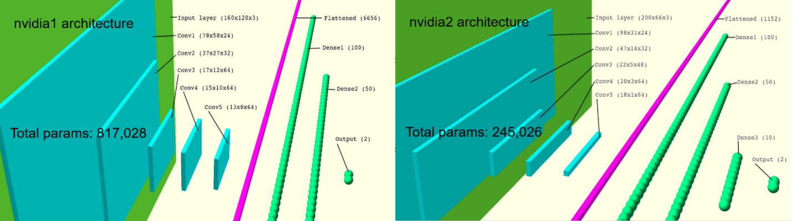
Evaluation of self-driving cars using CNNs in the rain
Conclusions - Geometry matters

Slide 14
My OOD journey so far - 2019/2022
Evaluation of self-driving cars using CNNs in the rain
3D Shape Estimation of Transparent Objects
Evaluation of autonomous systems under data distribution shifts
Notes:
3D Shape Estimation of Transparent Objects

Slide 15
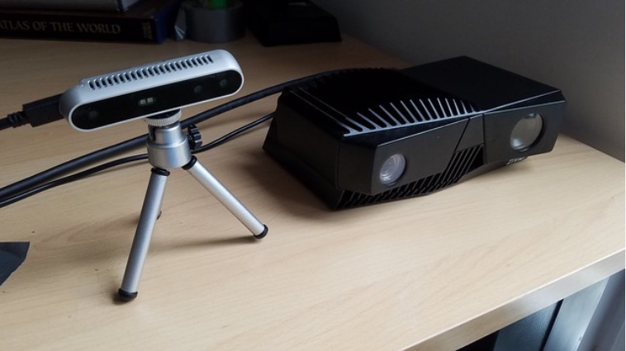
3D Shape Estimation of Transparent Objects
RGB-D cameras, Intellisense D415, Zivid One+

Slide 16
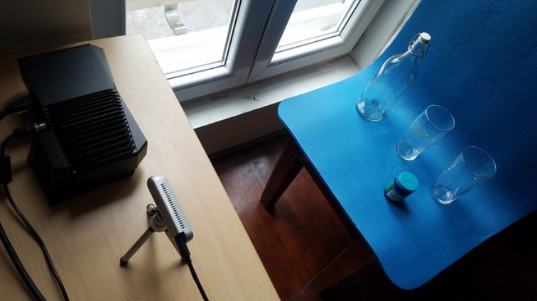
3D Shape Estimation of Transparent Objects
RGB-D cameras, Intellisense D415, Zivid One+

Slide 17
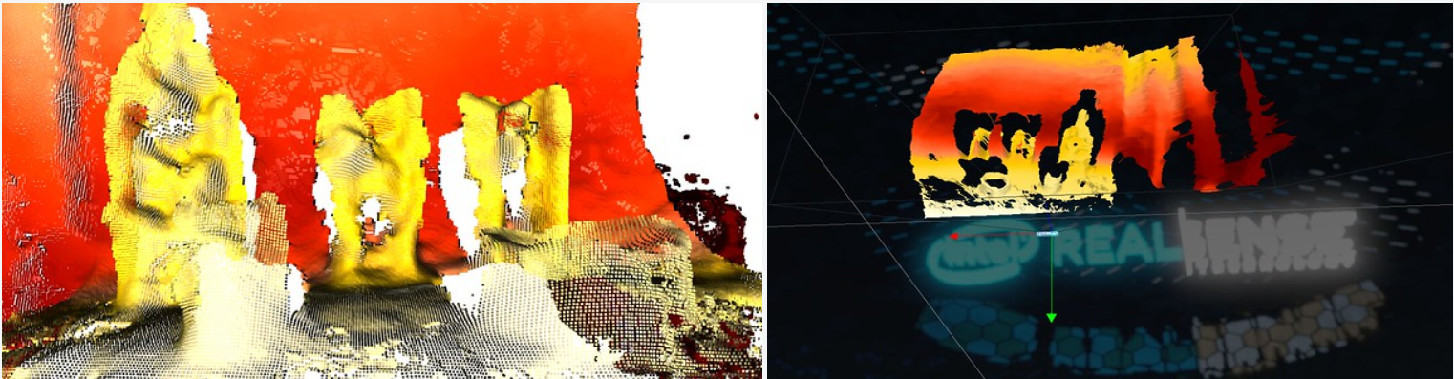
3D Shape Estimation of Transparent Objects
RGB-D - noise due to physical properties of transparent objects

Slide 18
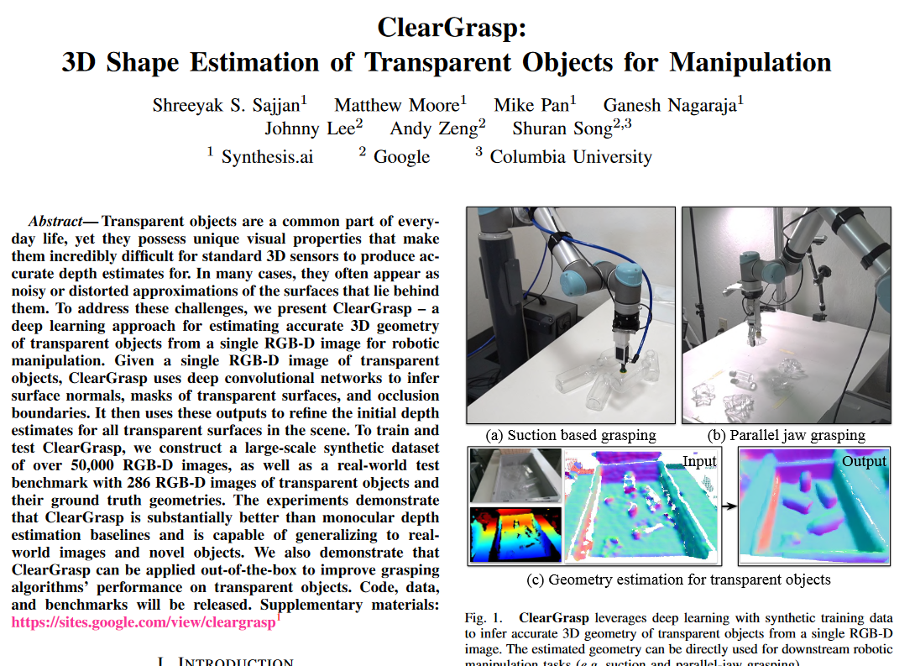
3D Shape Estimation of Transparent Objects
Sajjan et. al 2019, https://arxiv.org/pdf/1910.02550.pdf

Slide 19
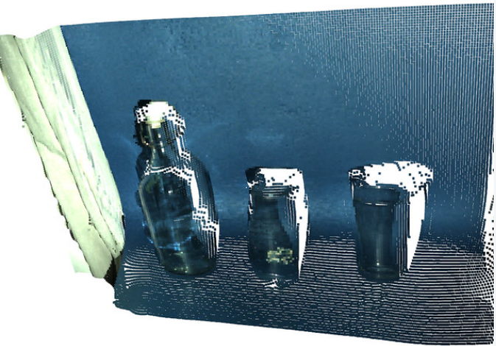
3D Shape Estimation of Transparent Objects
Solution, scale Zivid One+ distribution, to approximate D415 distribution, to apply Cleargrasp pipeline

Slide 20
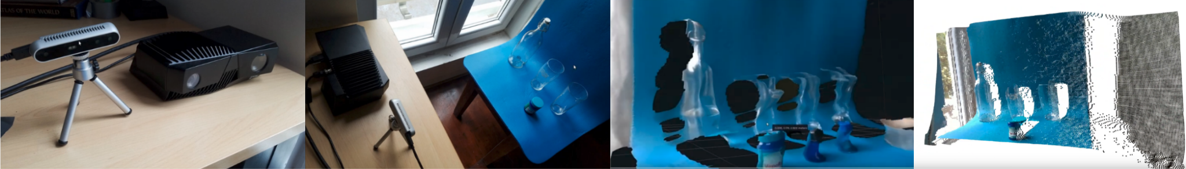
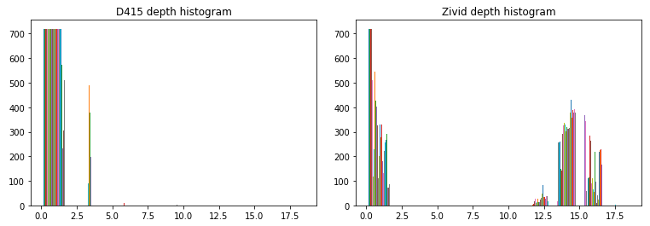
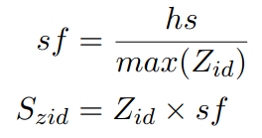
3D Shape Estimation of Transparent Objects
Where sf is the scaling factor hs is the histogram shift factor, Zid is the Zivid One+ input depth and Szid is the Scaled Zid.
Solution, scale Zivid One+ distribution, to approximate D415 distribution, to apply Cleargrasp pipeline

Slide 21
My OOD journey so far - 2019/2022
Evaluation of self-driving cars using CNNs in the rain
3D Shape Estimation of Transparent Objects
Evaluation of autonomous systems under data distribution shifts
Notes:
3D Shape Estimation of Transparent Objects

Slide 22
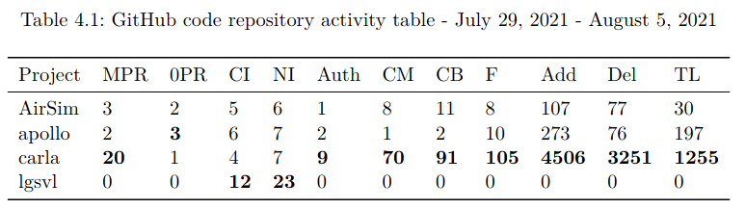
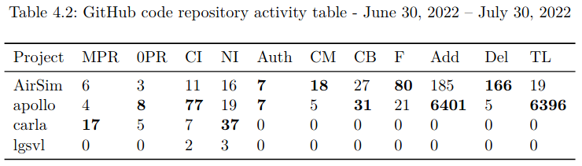
Choosing next generation tools

Slide 23
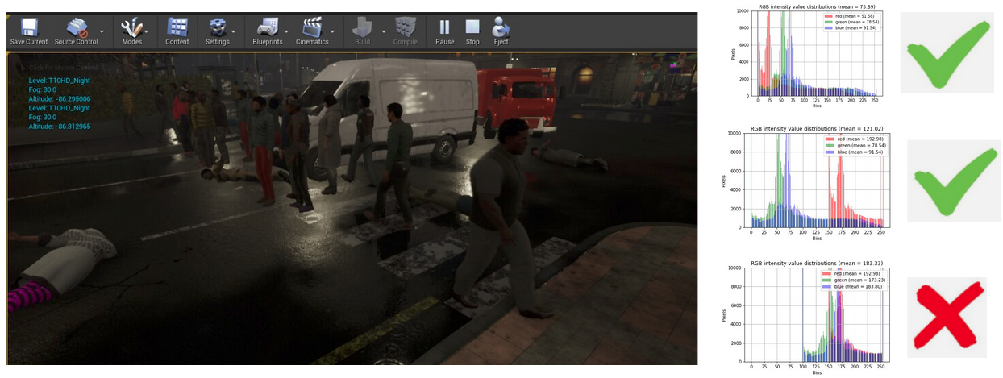
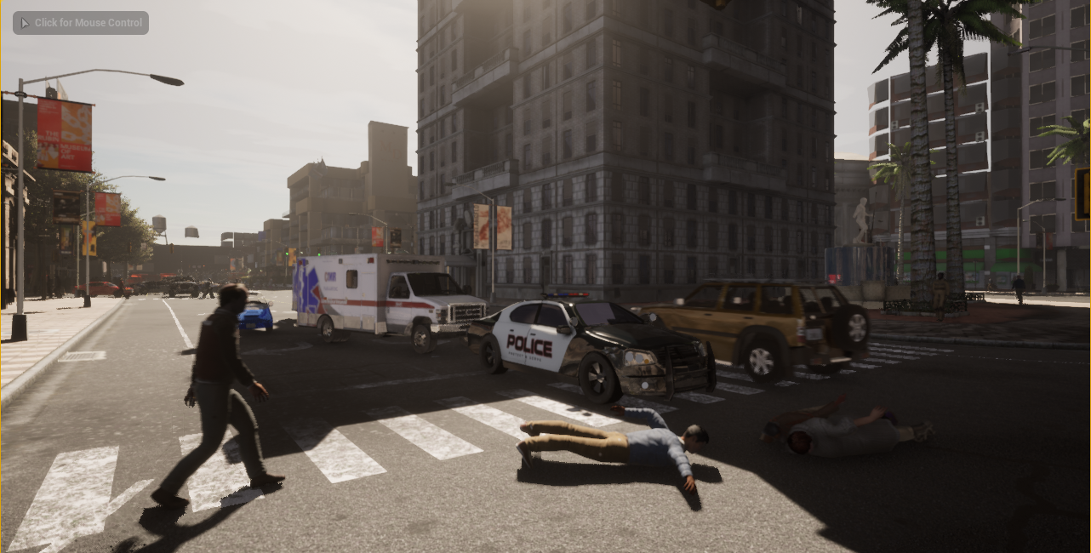
Goal - In the context of autonomous systems, determine what data distribution is safe to use

Slide 24
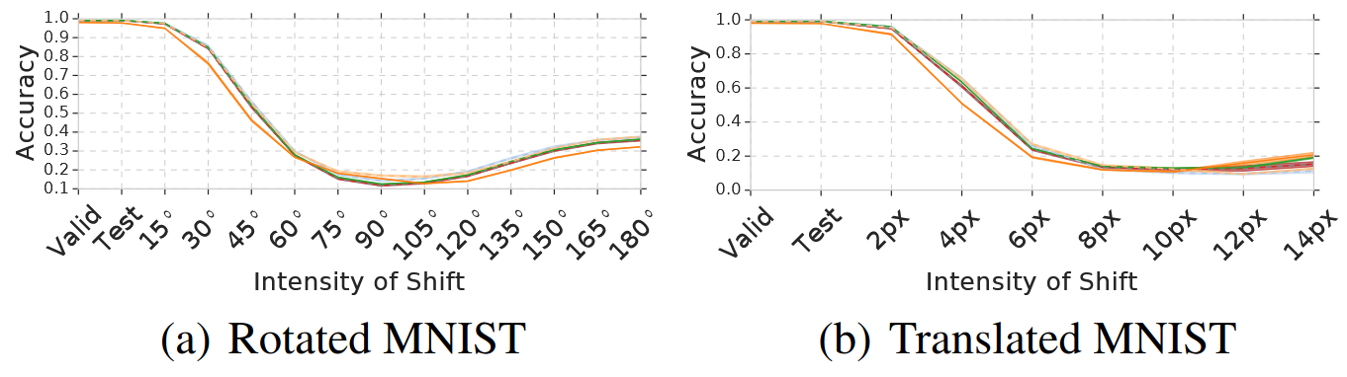
Related Work
Ovadia et al., NeurIPS 2019

Slide 25
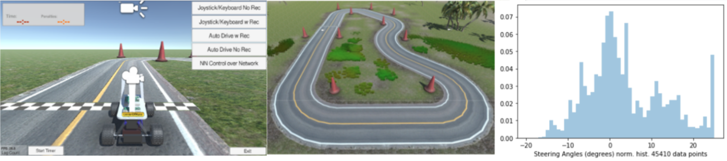
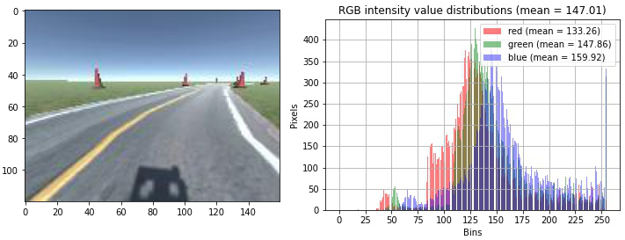
Method - Shift distribution and compute accuracy

Slide 26
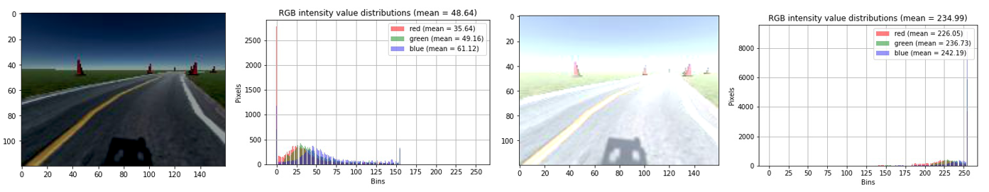
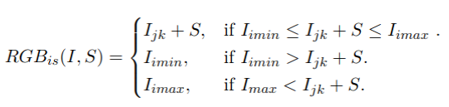
Method - distribution shift
Where RGBis is the RGB intensity shift function
I is the RGB image pixel matrix
S is the shift quantity to be added to each pixel
Iimin is the RGB lower value limit
Iimax is the RGB upper value limit
j are the dimensions of I
k are the elements of of j
S takes both negative and positive values
Evaluation of Convolutional Neural Networks Under Data Distribution Shifts

Slide 27
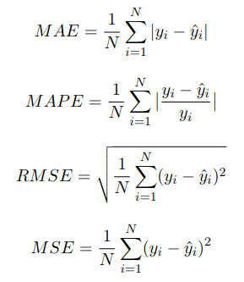
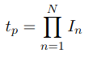
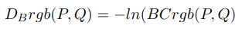
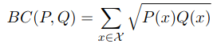
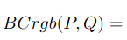
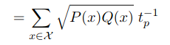
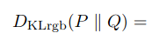
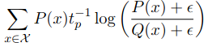
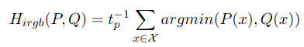
Error and Distance Metrics

Slide 28
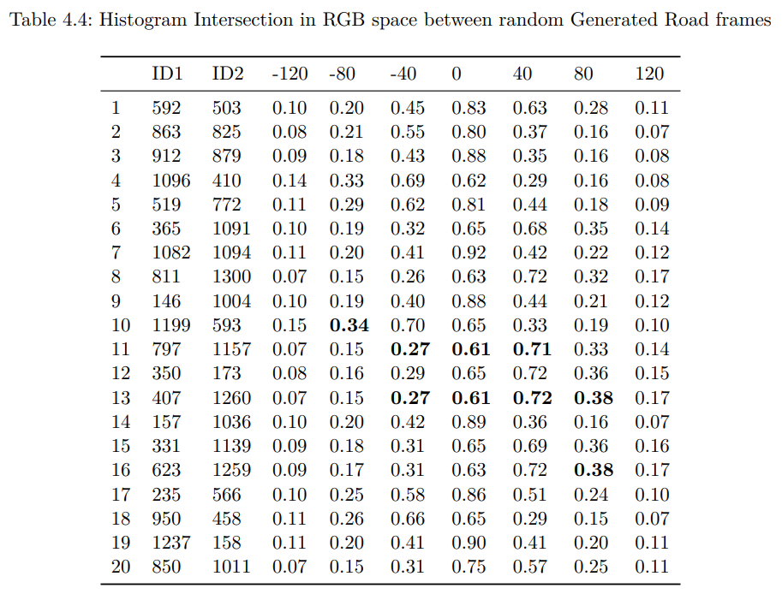
Method - Distance between random image pairs

Slide 29
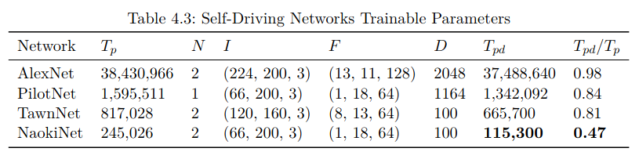
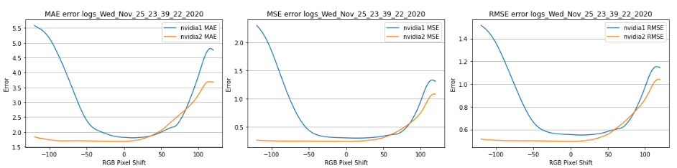
Related Work
Evaluation of Convolutional Neural Networks Under Data Distribution Shifts

Slide 30
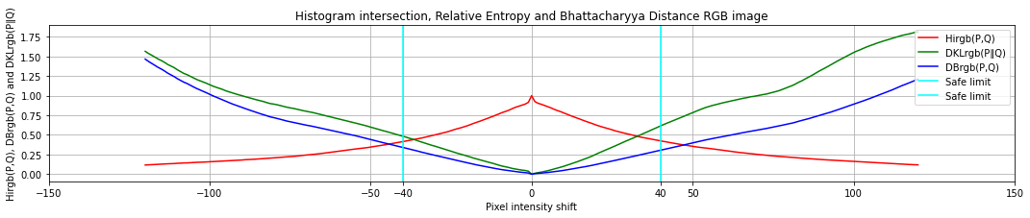
Distribution shift results
10 million + predictions
~1400 frames x 241 shifts x
(RGB Space + YUV Space)

Slide 31
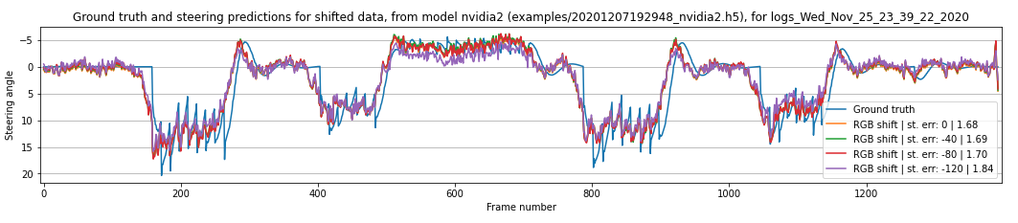
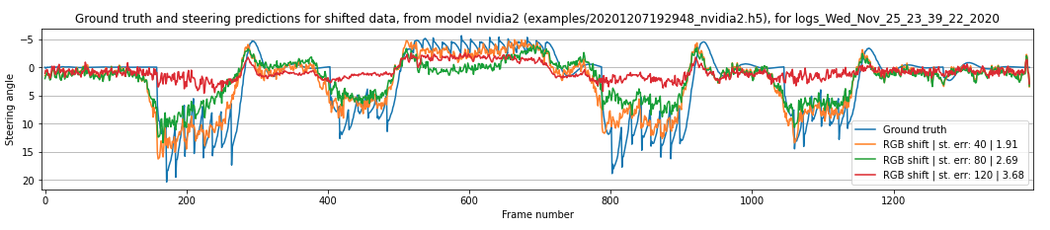
Methods - shift distribution and compute accuracy

Slide 32
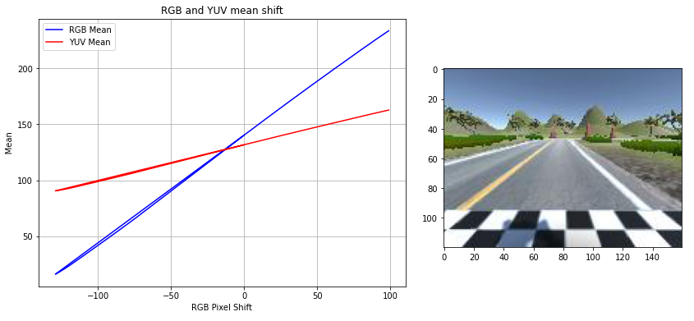
RGB x YUV mean shift
yrgb = 0.94xrgb + 140, yyuv = 0.34xyuv + 130
Evaluation of Convolutional Neural Networks Under Data Distribution Shifts

Slide 33


Steering prediction error metrics
Evaluation of Convolutional Neural Networks Under Data Distribution Shifts

Slide 34
Steering prediction error metrics - Generated Track
Evaluation of Convolutional Neural Networks Under Data Distribution Shifts

Slide 35


Steering prediction error metrics - Generated Road
Ealuation of Convolutional Neural Networks Under Data Distribution Shifts

Slide 36


Average RGB and YUV pixel intensity values

Slide 37

Average RGB and YUV pixel intensity values
Evaluation of Convolutional Neural Networks Under Data Distribution Shifts

Slide 38

Distribution shift distance - RGB and YUV space
Distance between negative and positive shifts, Hirgb, higher is better, smaller otherwise

Slide 39

Method - distance between first and every following frame
Distance between negative and positive shifts, Hirgb, higher is better, smaller otherwise
Distance between first and every following frame

Slide 40

Safe Limits YUV space
Evaluation of Convolutional Neural Networks Under Data Distribution Shifts

Slide 41


Safe Limits
Evaluation of Convolutional Neural Networks Under Data Distribution Shifts

Slide 42
Safe Limits

Slide 43
Safe Limits

Slide 44
Evaluation of autonomous systems under data distribution shifts
Conclusions
Network prediction accuracy changes as a result of data distribution shift
Based on the training data distribution, testing data is safe to use up for distributions up to a defined distance from training data

Slide 45
My OOD journey so far - 2019/2022
Evaluation of self-driving cars using CNNs in the rain
3D Shape Estimation of Transparent Objects
Evaluation of autonomous systems under data distribution shifts
Notes:
3D Shape Estimation of Transparent Objects

Slide 46
FRE mini-talks
Thanks for watching! Questions?
My OOD journey so far - 2019/2022
Daniel Sikar - daniel.sikar@city.ac.uk, daniel.sikar@fujitsu.com
PhD Candidate City University of London
Robust Water Segmentation Researcher - Fujitsu Research of Europe

